Slide 1


The Role of Business Analysts in Growing the Value of Businesses
Presented by
Strategic Advisor and Business Mentor
sean.nikookar@excellentsense.com
© Copyright Excellent Sense Pty Ltd - All rights reserved

Slide 2
Agenda
Business Value: What, Why, and How
People eXperience Excellent
The Role of Business Analyst
© Copyright Excellent Sense Pty Ltd - All rights reserved

Slide 3
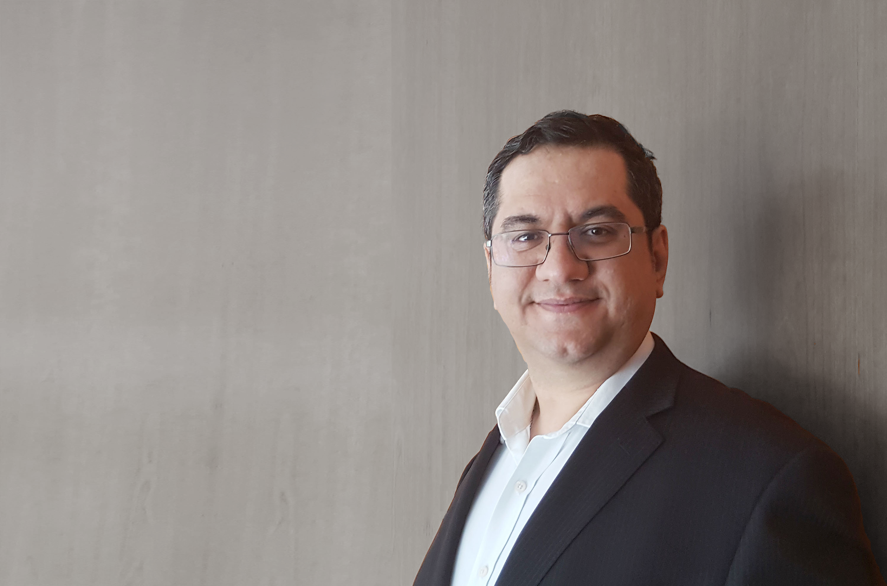
MY STORY
© Copyright Excellent Sense Pty Ltd - All rights reserved

Slide 4
Agenda
Business Value: What, Why, and How
People eXperience Excellent
The Role of Business Analyst
© Copyright Excellent Sense Pty Ltd - All rights reserved

Slide 5
Business Value: What, Why, and How
Business value is a term that includes all forms of value that determine the health and well-being of the business in the long run.
© Copyright Excellent Sense Pty Ltd - All rights reserved

Slide 6
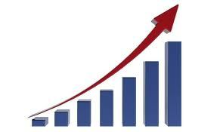
Business Value: What, Why, and How
Business value is a term that includes all forms of value that determine the health and well-being of the business in the long run.
© Copyright Excellent Sense Pty Ltd - All rights reserved

Slide 7


Business Value: What, Why, and How
© Copyright Excellent Sense Pty Ltd - All rights reserved

Slide 8
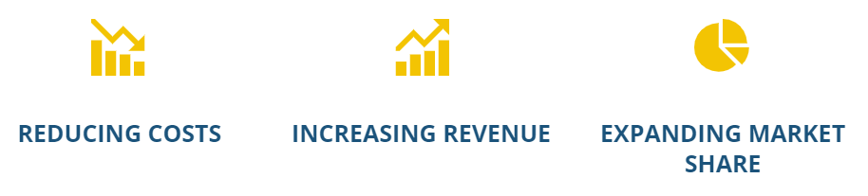
Business Value: What, Why, and How
© Copyright Excellent Sense Pty Ltd - All rights reserved

Slide 9
Business Value: What, Why, and How
Customer Satisfaction
Valuable Services
Employee Engagement
Powerful business systems
© Copyright Excellent Sense Pty Ltd - All rights reserved

Slide 10
Business Value: What, Why, and How
Customer Satisfaction
Valuable Services
Employee Engagement
Powerful business systems
© Copyright Excellent Sense Pty Ltd - All rights reserved

Slide 11
Agenda
Business Value: What, Why, and How
People eXperience Excellent
The Role of Business Analyst
© Copyright Excellent Sense Pty Ltd - All rights reserved

Slide 12
What is the Human eXperience?
A Human eXperience (HX) is the result of a conscious human mind observing an event.
© Copyright Excellent Sense Pty Ltd - All rights reserved

Slide 13
What is the Human eXperience?
A Human eXperience is the result of a conscious human mind observing an event.
Physical | Emotional |Spiritual
© Copyright Excellent Sense Pty Ltd - All rights reserved

Slide 14

Why HX is important?
People have an inherent curiosity.
© Copyright Excellent Sense Pty Ltd - All rights reserved

Slide 15

It is all about …
FEELING
© Copyright Excellent Sense Pty Ltd - All rights reserved

Slide 16

Feeling …
EMOTIONS
© Copyright Excellent Sense Pty Ltd - All rights reserved

Slide 17
Feeling …
EMOTIONS
Emotion is often defined as a complex state of feeling that results in physical and psychological changes that influence thought and behavior.
© Copyright Excellent Sense Pty Ltd - All rights reserved

Slide 18
There are three parts to an emotion …
Emotion
Subjective
Physiological
Expressive
© Copyright Excellent Sense Pty Ltd - All rights reserved

Slide 19
There are three parts to an emotion …
Emotion
Subjective
Physiological
Expressive
How you experience the emotion
How you behave in response to the emotion
How your bodies react to the emotion
© Copyright Excellent Sense Pty Ltd - All rights reserved

Slide 20
HX includes …
HX
CX
EX
LX
TX
IX
© Copyright Excellent Sense Pty Ltd - All rights reserved

Slide 21
People’s Requirements and Expectations
A requirement is simply a statement provided by a person (in our case, a customer or an employee) about what they believe they need and want in order to solve a problem or take a new opportunity.
© Copyright Excellent Sense Pty Ltd - All rights reserved

Slide 22
People’s Requirements and Expectations
A requirement is simply a statement provided by a person (in our case, a customer or an employee) about what they believe they NEED and WANT in order to solve a problem or take a new opportunity.
© Copyright Excellent Sense Pty Ltd - All rights reserved

Slide 23
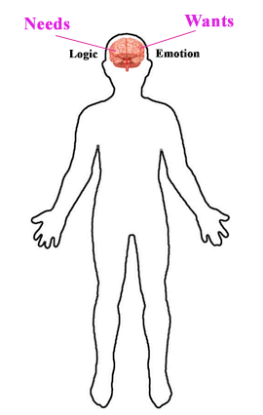
People’s Requirements and Expectations
A requirement is simply a statement provided by a person (in our case, a customer or an employee) about what they believe they NEED and WANT in order to solve a problem or take a new opportunity.
© Copyright Excellent Sense Pty Ltd - All rights reserved

Slide 24
People’s Requirements and Expectations
An expectation is to think that someone (or a business) should behave in a particular way or do a particular thing.
© Copyright Excellent Sense Pty Ltd - All rights reserved

Slide 25
Agenda
Business Value: What, Why, and How
People eXperience Excellent
The Role of Business Analyst
© Copyright Excellent Sense Pty Ltd - All rights reserved

Slide 26

What is the role of a BA in projects?
© Copyright Excellent Sense Pty Ltd - All rights reserved

Slide 27
You should focus on …
Human-Centric Approach
© Copyright Excellent Sense Pty Ltd - All rights reserved

Slide 28
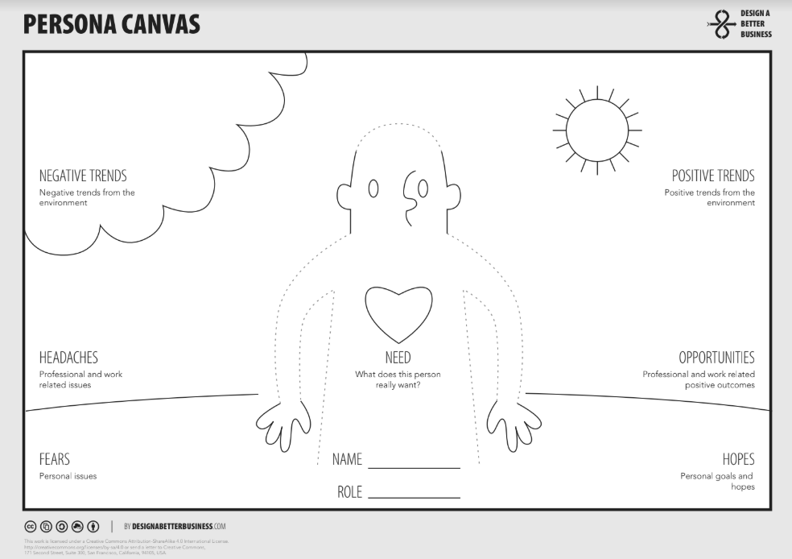
Persona …
© Copyright Excellent Sense Pty Ltd - All rights reserved

Slide 29
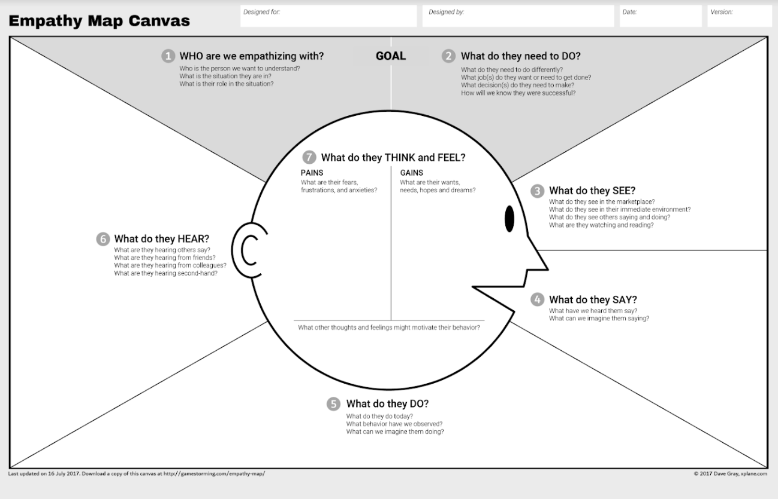
Empathy Map …
© Copyright Excellent Sense Pty Ltd - All rights reserved

Slide 30
Journey Map …
Current State Journey Map
Future State Journey Map
Daily Life State Journey Map
© Copyright Excellent Sense Pty Ltd - All rights reserved

Slide 31
Journey Map …
Lens
Experience
Insight
© Copyright Excellent Sense Pty Ltd - All rights reserved

Slide 32
Journey Map – Lens Section
The lens section provides constraints for the map by assigning a persona (“who”) and the scenario to be examined (“what”).
© Copyright Excellent Sense Pty Ltd - All rights reserved

Slide 33
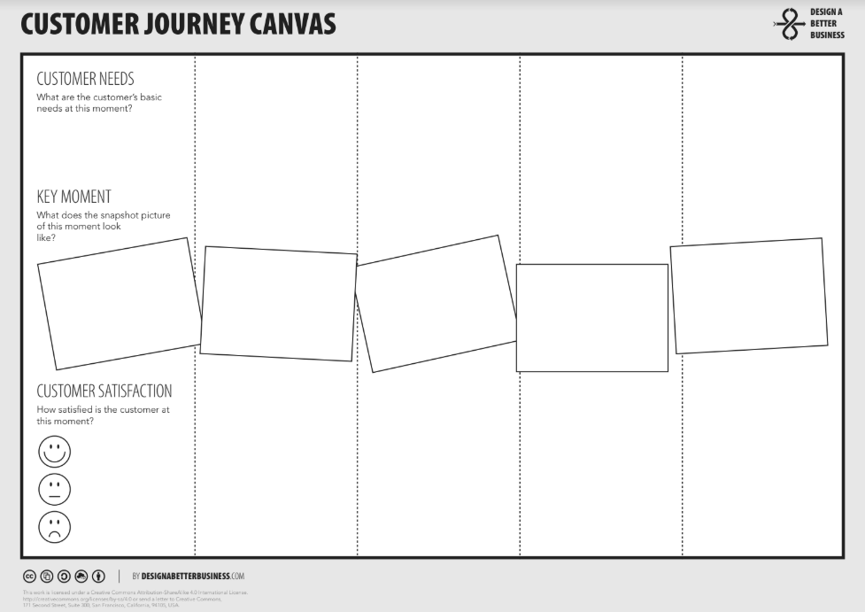
Journey Map – Experience Section
The experience section provides the visualized experience, usually aligned across chunkable phases of the journey.
© Copyright Excellent Sense Pty Ltd - All rights reserved

Slide 34
Journey Map – Insight Section
The insight section provides pain points discovered, and the opportunities to focus on going forward, as well as internal ownership.
© Copyright Excellent Sense Pty Ltd - All rights reserved

Slide 35
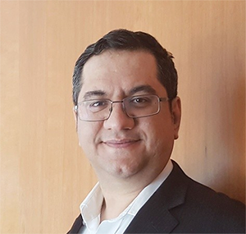



www.linkedin.com/in/seannikookar
sean.nikookar@exccellentsense.com
www.CareerByDesign.biz
The career development and Branding programs and services for corporate professionals who work in the project environment and want to build a career for the life they deserve.
www.ValuedPeople.biz
The management coaching and consulting programs and services for enabling small service-based businesses to grow their business values through People eXperience Excellent.
VALUEDPEOPLE
© Copyright Excellent Sense Pty Ltd - All rights reserved

